Slide 1
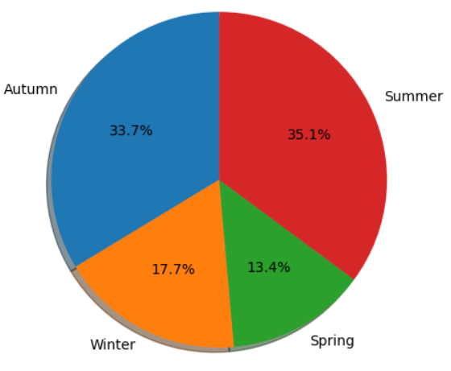
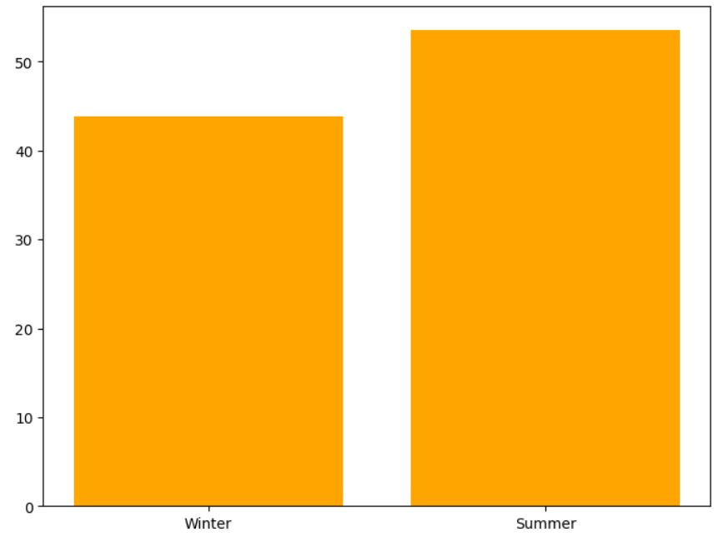
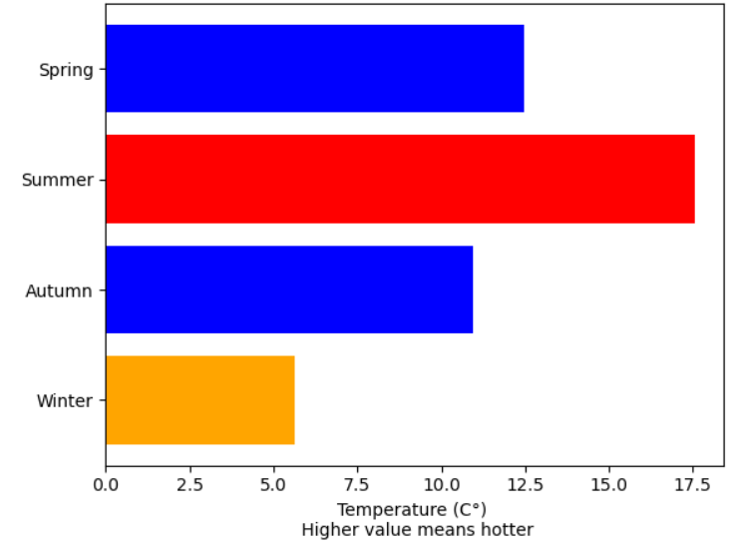
Seasonal summary of the weather 2017
The start of the data recording
09/10/2016
The range between the highest (summer) and the lowest humidity season (winter) is
9.7%
The average humidity of the highest and the lowest season
68.8% of the rainfall comes from Summer and Autumn (red and blue)
Percentage of rainfall contributed in seasons
Summer - highest average (17.5 °C) outdoor temperature
Winter - lowest average (5.6 °C) outdoor temperature
The average temperature of each seasons
Oct
Nov
Dec
Jan
Feb
Mar
Apr
May
Jun
Jul
Aug
Sep
Oct
Highest rainfall recorded
23.2mm
21/11/2016
Autumn
Lowest outdoor temperature recorded
-1.81 °C
31/11/2016
Start of Winter
Highest outdoor temperature recorded
26.38 °C
19/06/2017
Summer
The end of the recording
09/10/2017

Slide 2
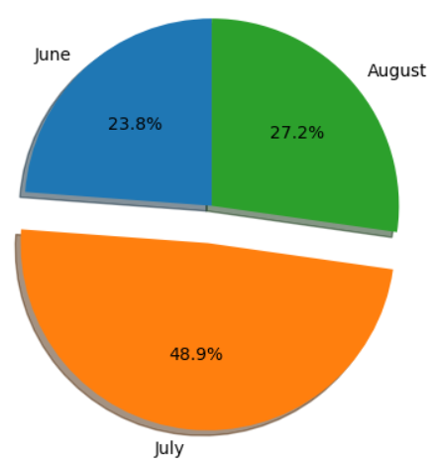
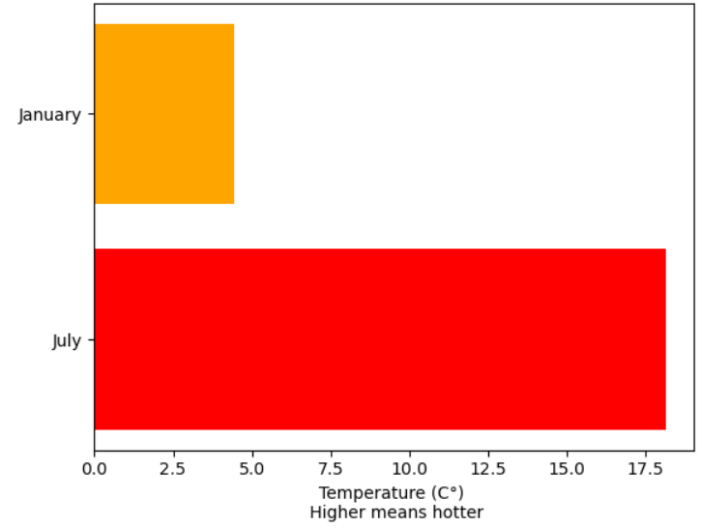
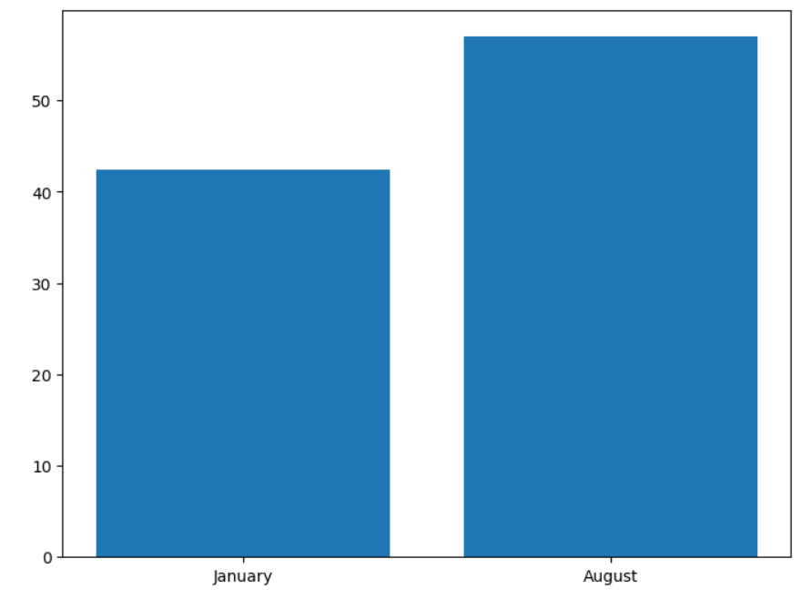
Monthly summary of the weather 2017
Highest recorded humidity
59%
23/08/2017
02/10/2017
August
October
The start of the data recording
09/10/2016
Highest air pressure recorded
1035.6 millibars
27/12/2016
December
Lowest recorded humidity
37%
27/01/2017
January
Oct
Nov
Dec
Jan
Feb
Mar
Apr
May
Jun
Jul
Aug
Sep
Oct
Nearly 50% of the rainfall in summer comes from July (orange)
Percentage of rainfall contributed in summer
July - highest average
(18.2 °C) outdoor temperature
January - lowest average
(4.4 °C) outdoor temperature
The average temperature of the highest and the lowest month
The range between the highest (Jan) and the lowest humidity month (Aug) is
14.5%
The average humidity of the highest and the lowest month
The end of the recording
09/10/2017

